Slide 1

Shiny
Web development through R

Slide 2
Outline
Workshop sessions
Introduction, Structure & Basics - 10th Jan
– Widgets, images, links and how to share
More advanced elements – 17th Jan
– Layout, themes & dashboards, formatting, mapping, plots and tables
Interactivity and renderUI – 24th Jan
Troubleshooting & “BYO-App” session Fisheries Informatics project – 31st Jan
– Optional hands on session
Github session

Slide 3
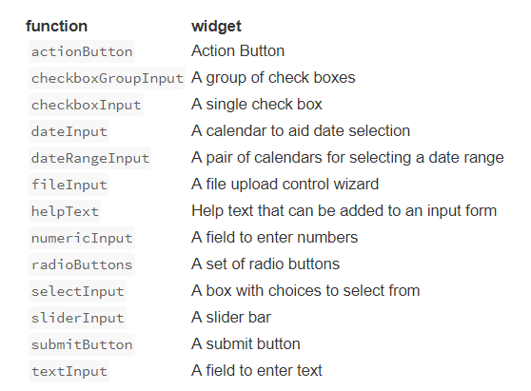
Widgets
inputs with visible/interactive elements
Widgets/inputs need;
A name for the widget. The user will not see this name but you can use it to access the widgets value and create reactive elements based on it. This is the inputId
A label. This should be a character string and will appear with the widget in your app. it can be an empty string “”.
In this example the inputId is “action” and the label is “Action”
Notes:
InputId is what the app recognizes the element by, it’s ‘name’ within the code
The label is what is displayed on the app and this is optional

Slide 4
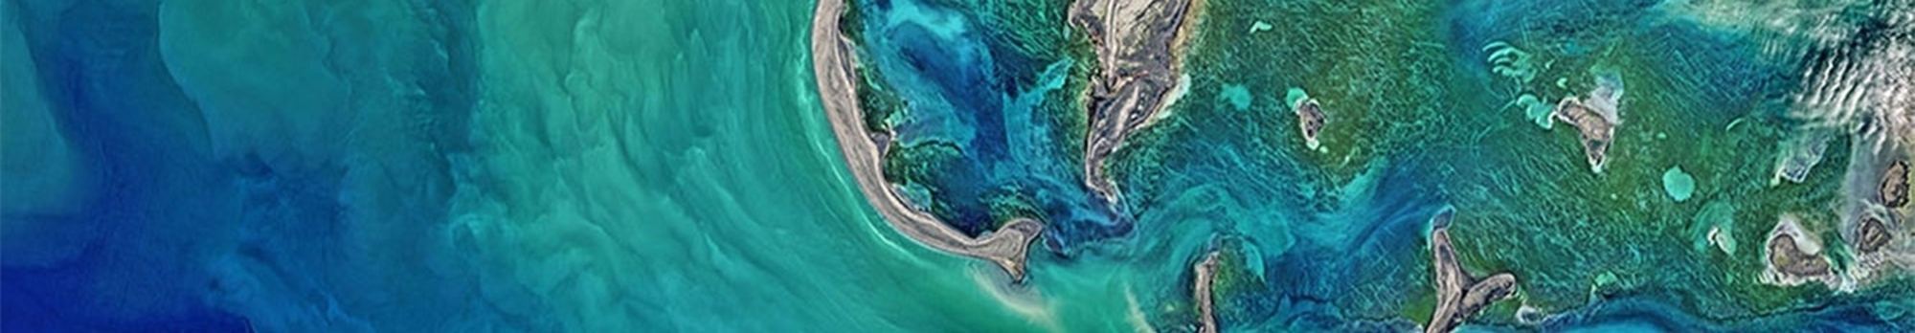
Fisheries Informatics Project
MI based project aiming to visualize existing data, increase its usage/utility and make it more easily accessible.
Outputs;
Species Dashboard
Digital Stockbook
IGFS data explorer
Cod tagging data portal

Slide 5
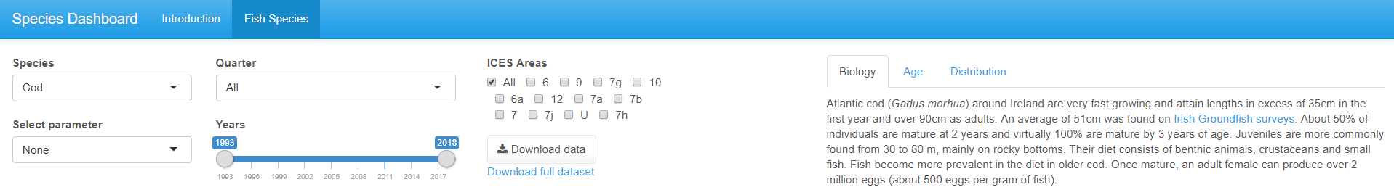
Species Dashboard
Pop-up message
Multiple tabs and complex ui structure
Interactive plots
showModal(modalDialog(
title = "Please note",
"This app is best viewed using Google Chrome",
footer = modalButton("OK"),
easyClose = TRUE
))
Explore more in layout section – Session 2
Full plotly explanation in session 2

Slide 6
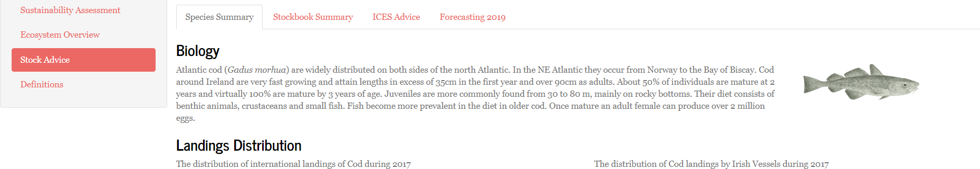
Digital Stockbook
Reactive filters
Reactive content
Selecting Stock different dropdown options based on species selected
renderUI
renderUI

Slide 7
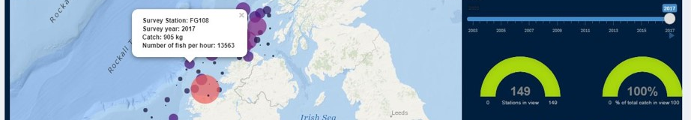
IGFS Data Explorer
Leaflet
View & download PDF
Reactive charts and infoboxes - UI
output$map <- renderLeaflet({
leaflet() %>%
addProviderTiles(providers$Esri.OceanBasemap) %>%
setView(lng = -8.2124, lat = 53.2734, zoom = 6)
})
observeEvent(input$modal1,{
showModal(modalDialog(
tags$iframe(style="height:800px; width:100%; scrolling=yes",
src=“myfile"),
title= “title",
easyClose = TRUE,
footer = NULL))
})
dashboardPage(
dashboardHeader(disable = TRUE),
dashboardSidebar(disable = TRUE),
dashboardBody(
fluidPage(fluidRow(valueBoxOutput("box1"),
valueBoxOutput("box2"),
valueBoxOutput("box3")
),

Slide 8
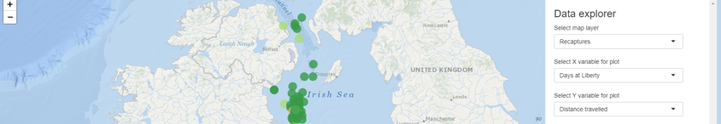
Cod tagging
Leaflet + adaptive page
Download map
leafletOutput(outputId = "map", width = "100%", height = "100%"),
absolutePanel(id = "controls", class = "panel panel-default", style = 'overflow-y:scroll;max-height:575px;', fixed = FALSE, draggable = FALSE, …)
downloadHandler(…)
Creates filename and writes content of file
downloadButton(outputId = "dl", label = "Download Map")

Slide 9

Session 2
Outline
Layout options
Themes & dashboards
HTML formatting
Mapping with Leaflet
Plots with plotly and ggplot
Tables with Datatable

Slide 10
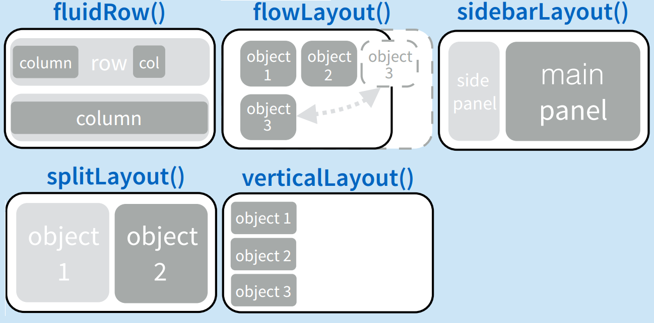
Layout
fluidPage
Most used and very flexible
titlePanel and sidebarLayout are most commonly used elements to add.
Combine multiple elements using different panel functions.
Organise panels and elements into a layout using a layout function with elements as arguments.

Slide 11
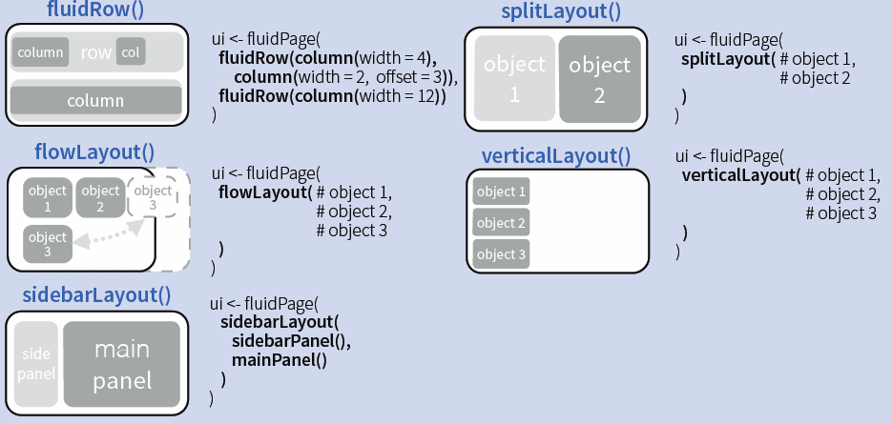
Layout code examples

Slide 12
Now you…
Build a few layouts with a vertical layout inside a sidebar

Slide 13
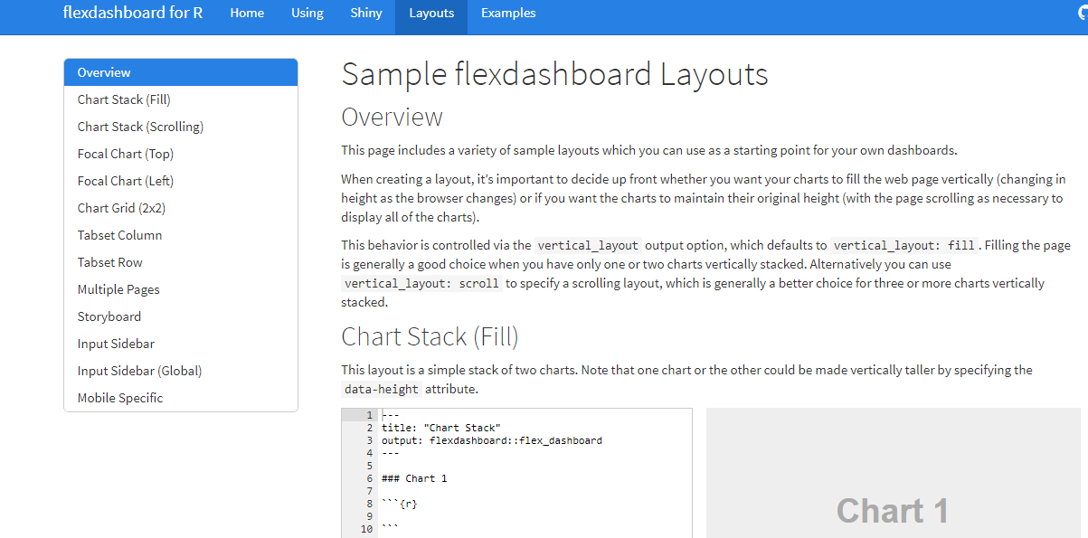
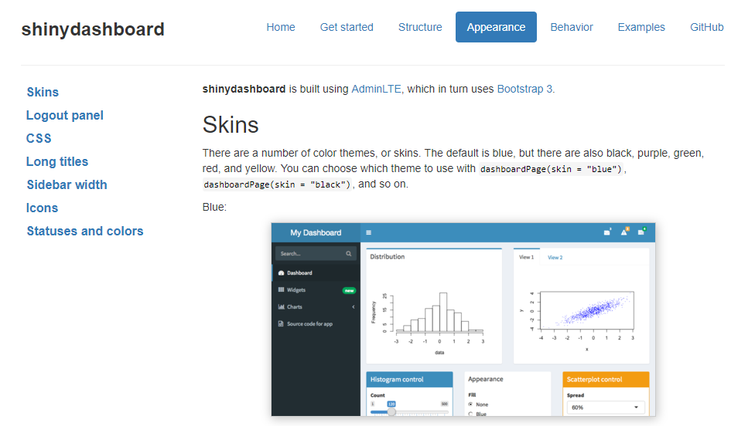
Layout
flexdashboard
shinydashboard
R Markdown
Super easy
Static or Dynamic
CSS flexbox layout
link
Shiny UI code, built using AdminLTE
Not quite as easy
Dynamic
Bookstrap grid layout
link
For more - layout-guide

Slide 14
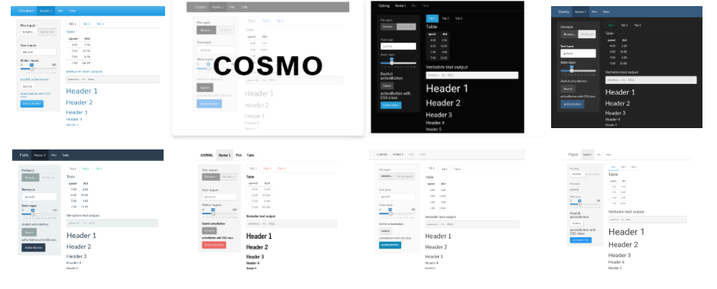
Shinythemes
https://rstudio.github.io/shinythemes/
Some options:

Slide 15
Now you…
Add a shinytheme to your app

Slide 16
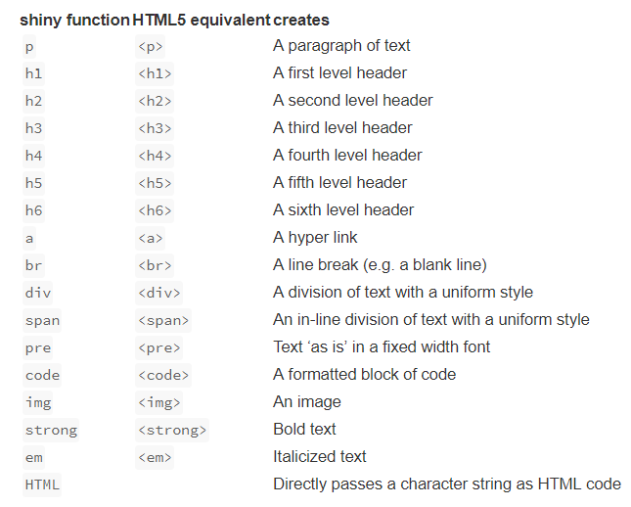
Adding content & Formatting
You can add content to your Shiny app by placing it inside a *Panel function e.g. sidebarPanel("sidebar panel")
Format text using inbuilt tags to create Headers, alter alignment, bole/italicize, change colour etc.
You can also customize your UI with HTML
Shiny HTML tags glossary
Notes:
You can add content to your Shiny app by placing it inside a *Panel function
Adding characters; html site hyperlink so you can look up the appropriate wrapper tag to allow you to include unusual characters (e.g. less than or equals to sign, subscript etc)

Slide 17
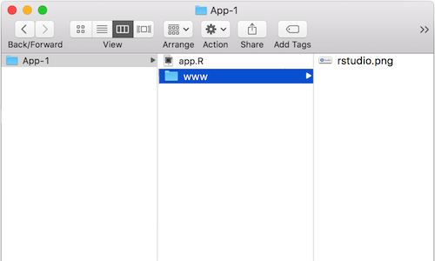
Images
‘img’ function with name of your image file as src argument
Can also include HTML friendly parameters like heights and width (numbers refer to pixels)
Img fuction looks for your image in a specific place; so your file must be in a folder named ‘www’ in the same directory as your app.r script.
So if you wanted to use an image called rstudio.png, your App-1 directory should look like this;

Slide 18
Now you…
Add an image

Slide 19
Adding links
runApp(
list(ui = fluidPage(
uiOutput("tab")
),
server = function(input, output, session){
url <- a("Google Homepage", href="https://www.google.com/")
output$tab <- renderUI({
tagList("URL link:", url)
})
})
)
HTML syntax within a block of text:
<a href="https://www.marine.ie/Home/home" target="_blank">www.marine.ie</a>
Notes:
Target=“_blank” – opens the link in a new tab, if this is removed it will open on the same page
The second link is what would appear in the text. Could be changed to “click here”

Slide 20
Now you…
Add a link to the MI webpage

Slide 21
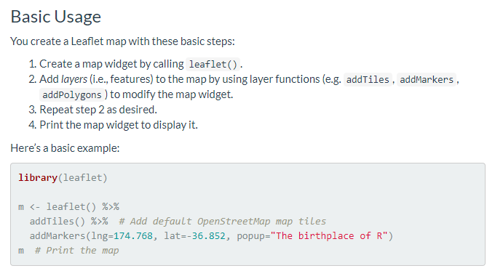
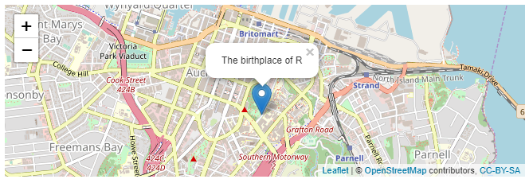
Mapping - leaflet
ui <- renderLeaflet(m)
More info: https://rstudio.github.io/leaflet/

Slide 22
Now you…
Add a map of the MI location

Slide 23
Incorporating plots/graphs
Plot fuction
Normal R plotting code inside renderPlot()
ggplot
Notes:
Tidyverse integration,

Slide 24
Interactive plots - Plotly
https://plot.ly/r/
Can also wrap ggplot inside renderPlotly(); will make your plot interactive

Slide 25
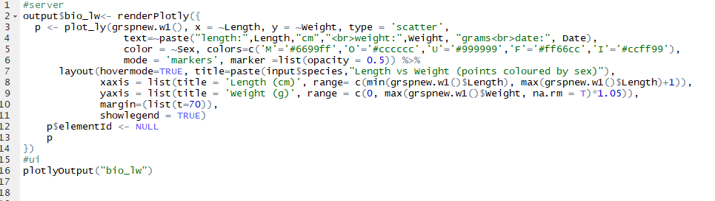
Plotly – species dashboard

Slide 26

Questions?

